Slide 1
Computer Architecture and Organization
Instruction Sets:
Addressing Modes and Formats
Chapter 11

Slide 2
Addressing Modes
Immediate
Direct
Indirect
Register
Register Indirect
Displacement (Indexed)
Stack
Notes:
2

Slide 3
Immediate Addressing Diagram
Instruction
Opcode
Operand
Notes:
4

Slide 4
Immediate Addressing
Operand is part of instruction
Operand = address field
e.g. ADD 5
  Add 5 to contents of accumulator
  5 is operand
No memory reference to fetch data
Fast
Limited range
Notes:
3

Slide 5
Direct Addressing Diagram
Instruction
Opcode
Address A
Memory
Operand
Notes:
6

Slide 6
Direct Addressing
Address field contains address of operand
Effective address (EA) = address field (A)
e.g. ADD AX,1000h
  Add contents of cell A to accumulator
  Look in memory at address A for operand
Single memory reference to access data
No additional calculations to work out effective address
Limited address space
Notes:
5

Slide 7
Indirect Addressing Diagram
Instruction
Opcode
Address A
Memory
Pointer to operand
Operand
Notes:
9

Slide 8
Indirect Addressing
Memory cell pointed to by address field contains the address of (pointer to) the operand
EA = (A)
  Look in A, find address (A) and look there for operand
e.g. ADD (A)
  Add contents of cell pointed to by contents of A to accumulator
Notes:
7

Slide 9
Indirect Addressing
Large address space
2^{n} where n = word length
May be nested, multilevel, cascaded
  e.g. EA = (((A)))
    Draw the diagram yourself
Multiple memory accesses to find operand
Hence slower
Notes:
8

Slide 10
Register Addressing Diagram
Instruction
Opcode
Register Address R
Registers
Operand
Notes:
12

Slide 11
Register Addressing
Operand is held in register named in address filed
EA = R
Limited number of registers
Very small address field needed
  Shorter instructions
  Faster instruction fetch
Notes:
10

Slide 12
Register Addressing
No memory access
Very fast execution
Very limited address space
Multiple registers helps performance
  Requires good assembly programming or compiler writing
  MOV R1,R2
Notes:
11

Slide 13
Register Indirect Addressing Diagram
Instruction
Opcode
Register Address R
Memory
Registers
Pointer to Operand
Operand
Notes:
14

Slide 14
Register Indirect Addressing
indirect addressing
EA = (R)
Operand is in memory cell pointed to by contents of register R
Large address space (2^{n})
One fewer memory access than indirect addressing
  MOV R1,(R2)
Memory Indirect Addressing
  MOV R1,[1000H]
Notes:
13

Slide 15
Displacement Addressing Diagram
Instruction
Opcode
Register R
Address A
Memory
Registers
Pointer to Operand
+
Operand
Notes:
16

Slide 16
Displacement Addressing
EA = A + (R)
Address field hold two values
  A = base value
  R = register that holds displacement
  or vice versa
Notes:
15

Slide 17
Indexed Addressing
A = base
R = displacement
EA = A + R
Good for accessing arrays
  EA = A + R
  R++
Notes:
19

Slide 18
INSTRUCTION FORMAT
(PENTIUM)

Slide 19
Instruction Formats
Layout of bits in an instruction
Includes opcode
Includes (implicit or explicit) operand(s)
Usually more than one instruction format in an instruction set

Slide 20
Instruction Length
Affected by and affects:
  Memory size
  Memory organization
  Bus structure
  CPU complexity
  CPU speed
  User wants more opcodes, operands, addressing modes , address range

Slide 21
Allocation of Bits
Number of addressing modes
Number of operands
Register versus memory
Number of register sets
Address range
Address Granularity

Slide 22
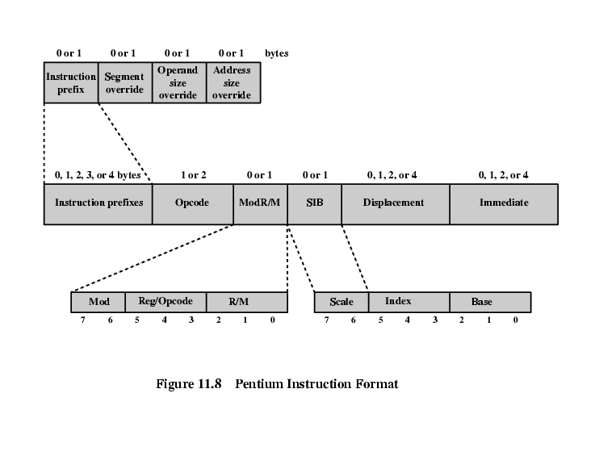
Pentium Instruction Format

Slide 23
PENTIUM INSTRUCTION FORMAT
Instruction Prefixes-LOCK prefix or one of the REPEAT prefixes
Segment Override-explicitly specifying segment register
Address Size-16 or 32 bit (switch)
Operand Size-16 or 32 bit (switch)

Slide 24
PENTIUM INSTRUCTION FORMAT
Opcode
Mod R/m-addressing
  Mod+ r/m (combined info of registers and addressing modes)
  Register-register or opcode info
SIB
  Scale-scale factor for scaled indexing
  Index-specifies index register
  Base-specifies base register
Displacement-8 or 16 or 32 bit
Immediate-provides the value of 8/16/32 bit operand

Slide 25
PENTIUM INSTRUCTION FORMAT
Instruction Prefixes-LOCK prefix or one of the REPEAT prefixes
Segment Override-explicitly specifying segment register
Address Size-16 or 32 bit (switch)
Operand Size-16 or 32 bit (switch)

Slide 26

Instruction Cycle State Diagram

Slide 27
Instruction Cycle
Notes:
35

Slide 28

Instruction Cycle
Two steps:
  Fetch
  Execute

Slide 29
Instruction Cycle
It is the time in which a single
instruction is fetched from memory,
decoded, and executed
An Instruction Cycle requires the following subcycle:

Slide 30
Instruction Cycle
Fetch
Read next instruction from memory into the processor
Indirect Cycle (Decode Cycle)
May require memory access to fetch operands, therefore more memory accesses.
Interrupt
Save current instruction and service the interrupt
Execute
Interpret the opcode and perform the indicated operation
Notes:
35

Slide 31
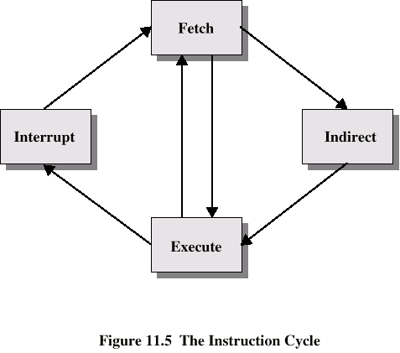
Instruction Cycle
Fetch
Fetch
Fetch
Fetch
Interrupt
Interrupt
Indirect
Indirect
Execute
Execute
Execute
Execute

Slide 32
Fetch Cycle
Program Counter (PC) holds address of next instruction to be fetched
Processor fetches instruction from memory location pointed to by PC
Increment PC
  Unless told otherwise
Instruction loaded into Instruction Register (IR)
Processor interprets instruction and performs required actions

Slide 33
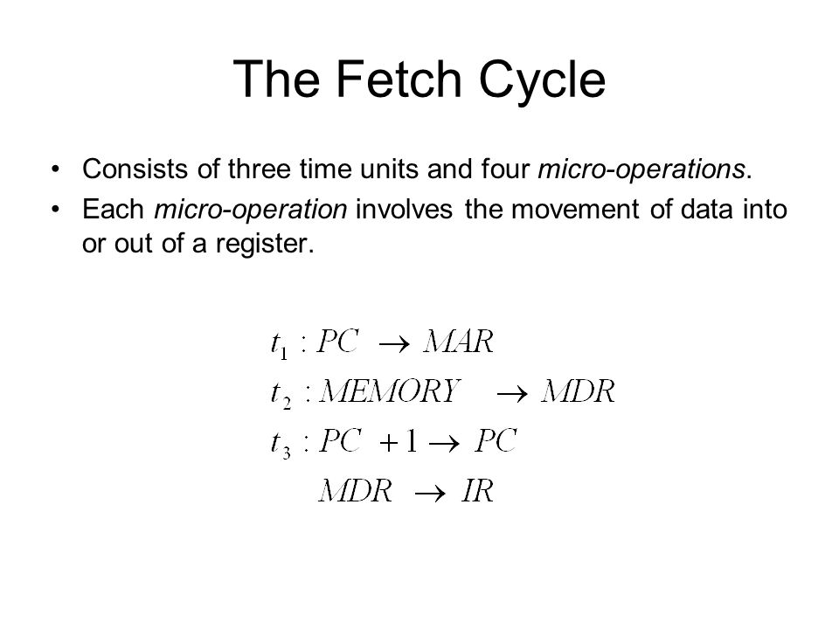


Slide 34
Execute Cycle
Processor-memory
  data transfer between CPU and main memory
Processor I/O
  Data transfer between CPU and I/O module
Data processing
  Some arithmetic or logical operation on data
Control
  Alteration of sequence of operations
  e.g. jump
Combination of above

Slide 35
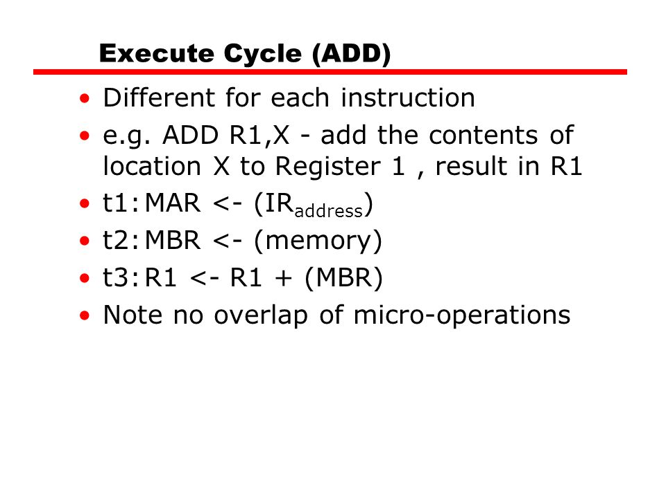

Slide 36
Indirect Cycle
May require memory access to fetch operands
Indirect addressing requires more memory accesses
Can be thought of as additional instruction subcycle

Slide 37
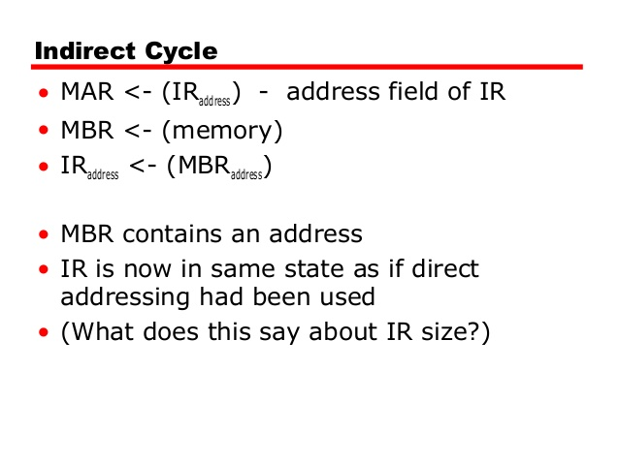

Slide 38
Data Flow (Interrupt)
Current PC saved to allow resumption after interrupt
Contents of PC copied to MBR
Special memory location (e.g. stack pointer) loaded to MAR
MBR written to memory
PC loaded with address of interrupt handling routine
Next instruction (first of interrupt handler) can be fetched

Slide 39
Interrupts
Mechanism by which other modules (e.g. I/O) may interrupt normal sequence of processing
Program
  e.g. overflow, division by zero
Timer
  Generated by internal processor timer
  Used in pre-emptive multi-tasking
I/O
  from I/O controller
Hardware failure
  e.g. memory parity error

Slide 40

Instruction Cycle with Interrupts

Slide 41

Data Flow (Fetch Diagram)
PC
PC
MAR
MAR
Memory
Memory
Memory
Control
Unit
Control
Unit
MBR
IR
MBR

Slide 42

Data Flow (Indirect Diagram)
MAR
MAR
Memory
Memory
Memory
Control
Unit
MBR
MBR

Slide 43

Data Flow (Interrupt Diagram)
PC
PC
PC
MAR
MAR
Memory
Memory
Memory
Control
Unit
Control
Unit
Control
Unit
Control
Unit
MBR
MBR

